Slide 1
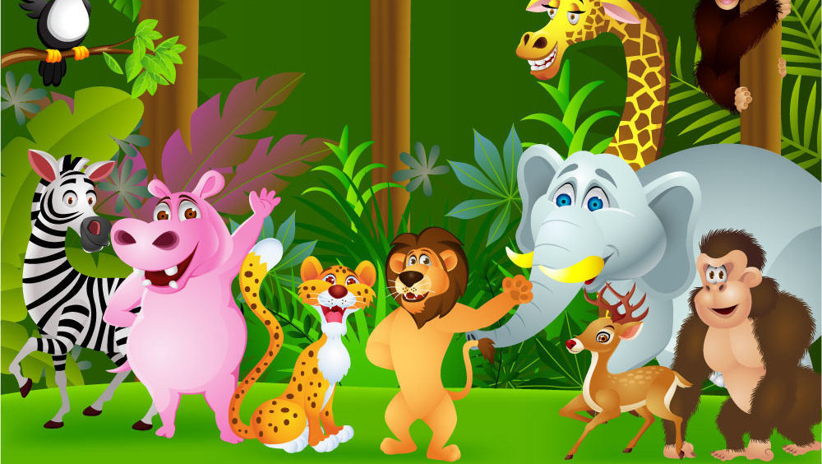
WELCOME TO PEEK-A-ZOO

Slide 2
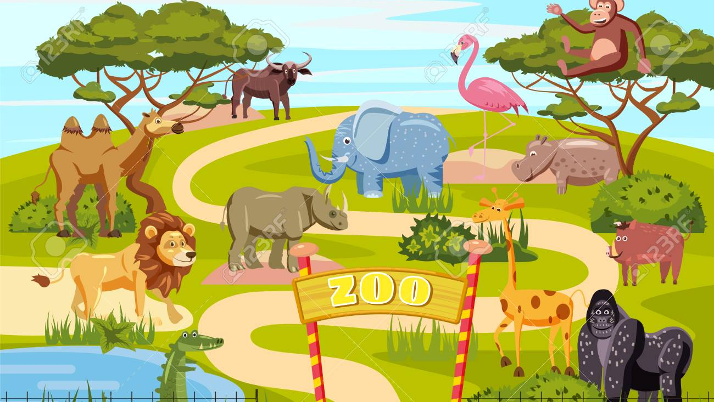
TO KNOW MORE ABOUT ANIMALS
ENDAGERED SPECIES ARE PROTECTED
BEST PLACE TO REFRESH
PEEK-A-ZOO

Slide 3

HOW THE APP IS CREATED-ALL ABOUT JUSTINMIND
The program creates high-fidelity PROTOTYPES.
Drag and drop placement, re-sizing, formatting and export/import of widgets.
Features for annotating widgets and defining interactions such as linking, animations, conditional linking, calculations, simulating tab controls, show/hide elements and database simulation with real data

Slide 4
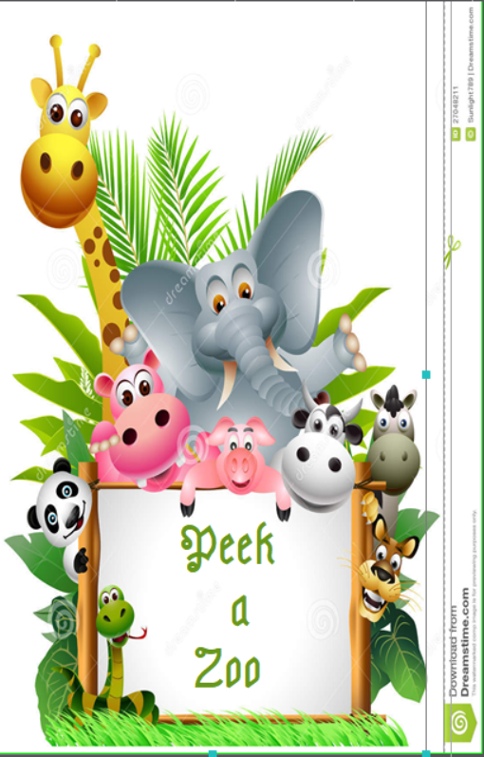
WELCOME PAGE
FIRST PAGE OF THE APP.
INCLUDES BACKGROUND IMAGE and TEXT.
AUTOMATICALLY GOES TO NEXT PAGE

Slide 5
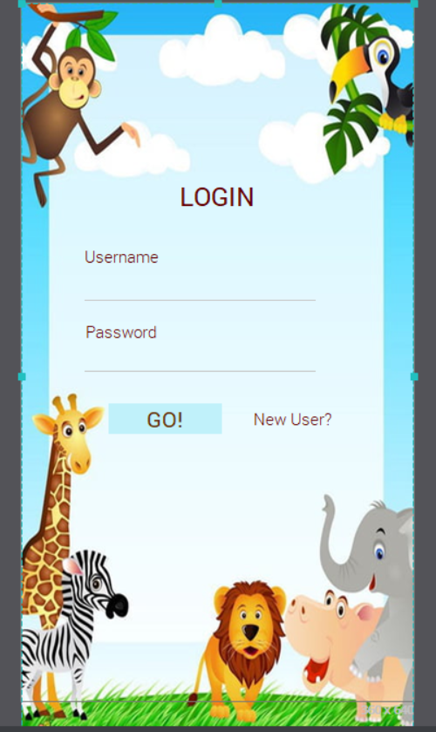
LOGIN PAGE
SECOND PAGE OF THE APP WHERE THE USER WILL GIVE THE INPUT AS USERNAME AND PASSWORD.
THE PAGE INCLUDES BUTTON,TEXTS,INPUTS and IMAGES
THE SIGN UP OPTION FOR NEW USER WILL REDIRECT TO NEW PAGE.

Slide 6
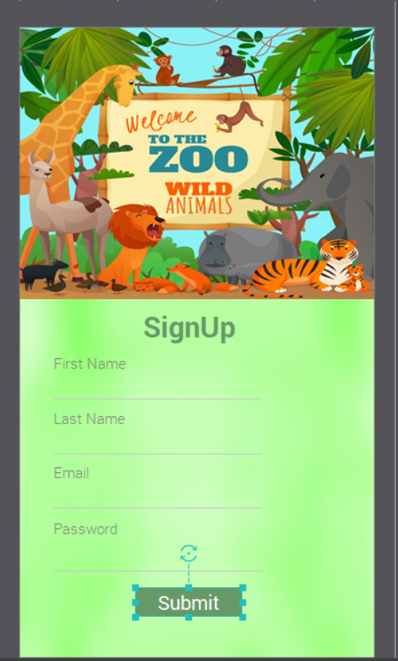
SIGN UP PAGE
THE 4 DIFFERENT INPUTS FROM USER WILL ALLOW THEM TO SET UP THEIR ACCOUNT ON THE APP.
THE PAGE INCLUDES BUTTON FOR SUBMIT,DIFFERENT INPUTS,TEXT and BACKGROUND IMAGE.
AFTER CLICKING ON BUTTON IT WILL MOVE TO LOGIN PAGE.

Slide 7
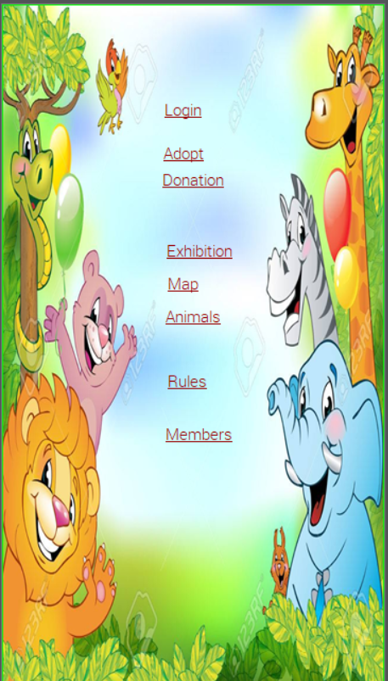
TITLE PAGE
THIS PAGE HAVE DIFFERENT LINKS TO MOVE TO THE OTHER PAGES OF THE APP.
THE NAMES OF THE OTHERS PAGES ARE TAKEN AS TEXTS AND THE BACKGROUND IMAGE.
BY CLICKING ON THE ANY OF THE LINK THAT PARTICULAR PAGE IS OPENED

Slide 8
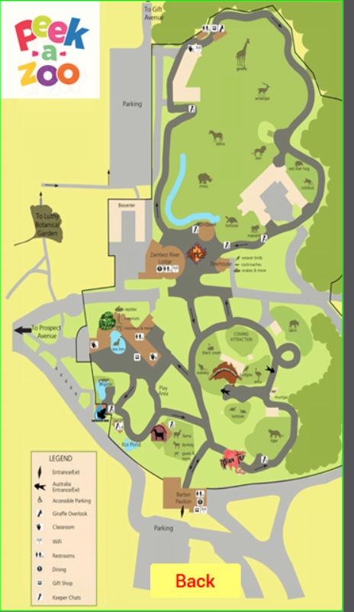
MAP
REPRESENTS THE MAP OF THE ZOO.
RAISED BUTTON IS USED TO GO BACK TO THE TITLE PAGE and IMAGES BEING USED

Slide 9
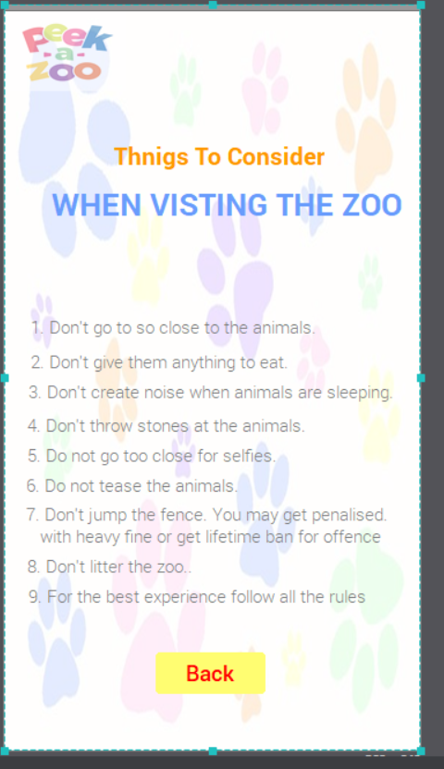
RULES
THE VARIOUS RULES FOR THE VISITORS.
USAGE OF RAISED BUTTON TO GO BACK TO TITLE PAGE.
RULES DESCRIBED IN THE FORM OF TEXTS.

Slide 10
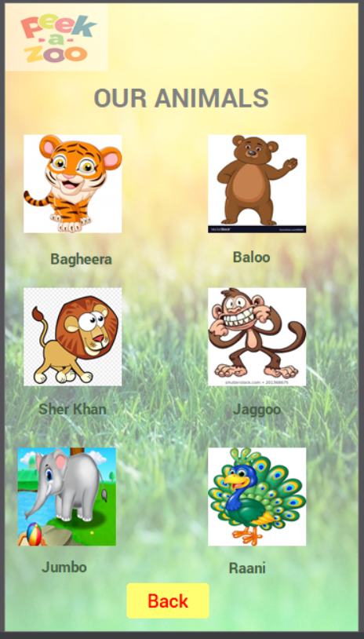
DIFFERENT ANIMALS
THIS PAGE SHOWS THE DIFFERENT TYPES OF ANIMALS IN THE ZOO
DIFFENRENT IMAGES, TEXTS and BUTTONS ARE USED FOR GOING BACK.

Slide 11
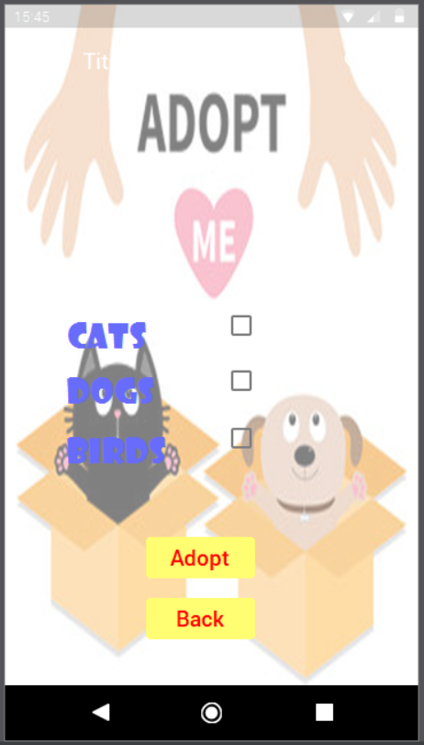
ADOPT
THE OPTION GIVES THE VISITORS CHANCE TO ADOPT.
USAGE OF BUTTONS,TEXTS and BACKGROUND IMAGE IS IMPLEMENTED.

Slide 12
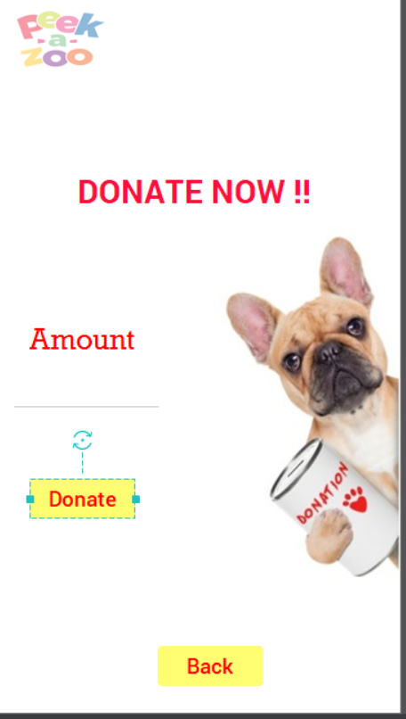
DONATION
VISITORS CAN DONATE TO THE ZOO.
INPUT FROM USER IS TAKEN,BUTTONS AND TEXTS ARE USED.

Slide 13
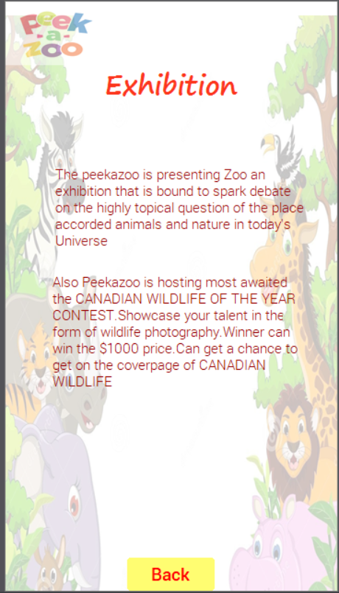
EXHIBITION PAGE
THIS PAGE SHOWS THE VARIOUS UPDATES IN THE ZOO .
BUTTONS ,TEXTS AND BACKGROUD IMAGE IS BEING USED.

Slide 14
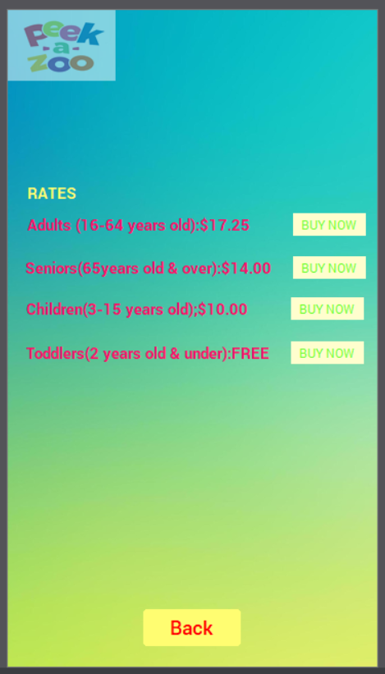
TICKETS
THIS GIVES OPTION TO THE VISITOR TO PURCHASE TICKETS ONLINE.
USAGE OF BUTTONS ,TEXTS AND BACKGROUNDS.

Slide 15
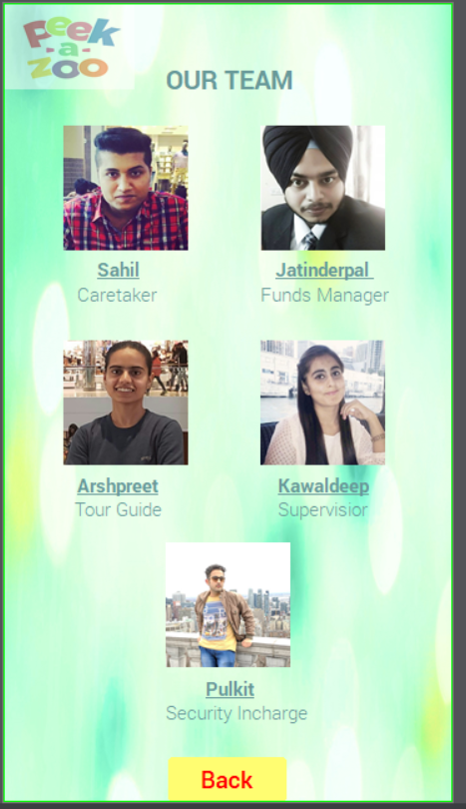
DIFFERENT MEMBERS OF ZOO
THE DIFFERENT MEMBERS HAVE RESPINSIBILITIES OF THE ZOO
IMAGES ,BUTTONS AND TEXTS ARE BEING USED.

Slide 16
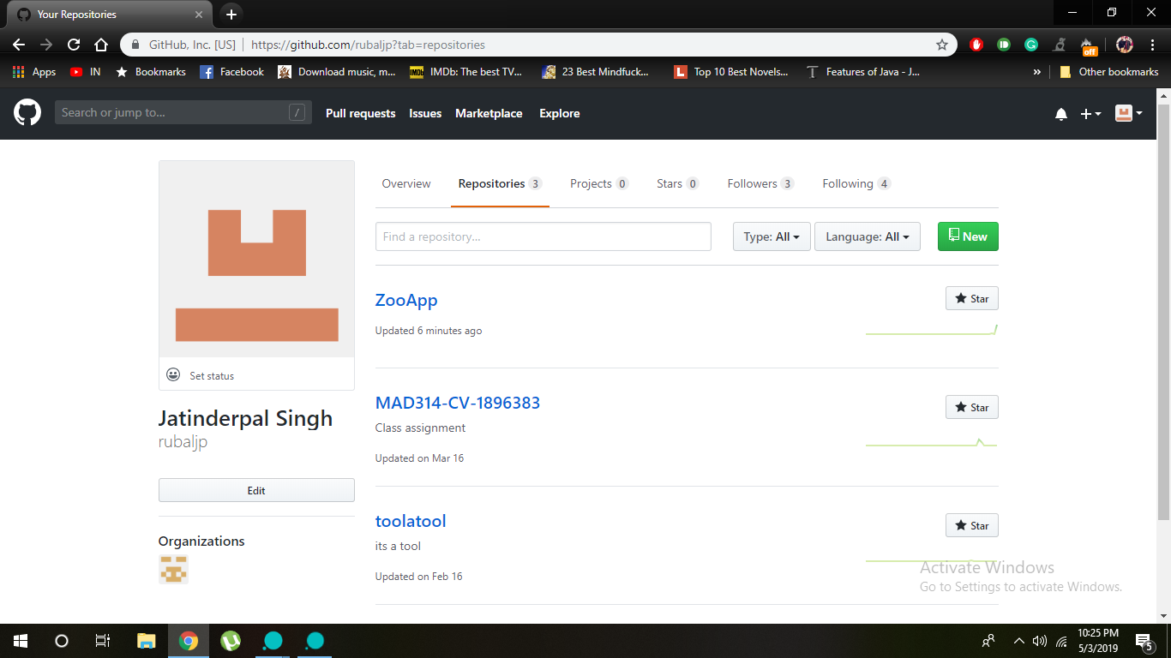
GIT HUB
THE REPOSITORY WAS MADE NAMED ZOOAPP
TO UPDATE THE WORK PROGRESS.

Slide 17
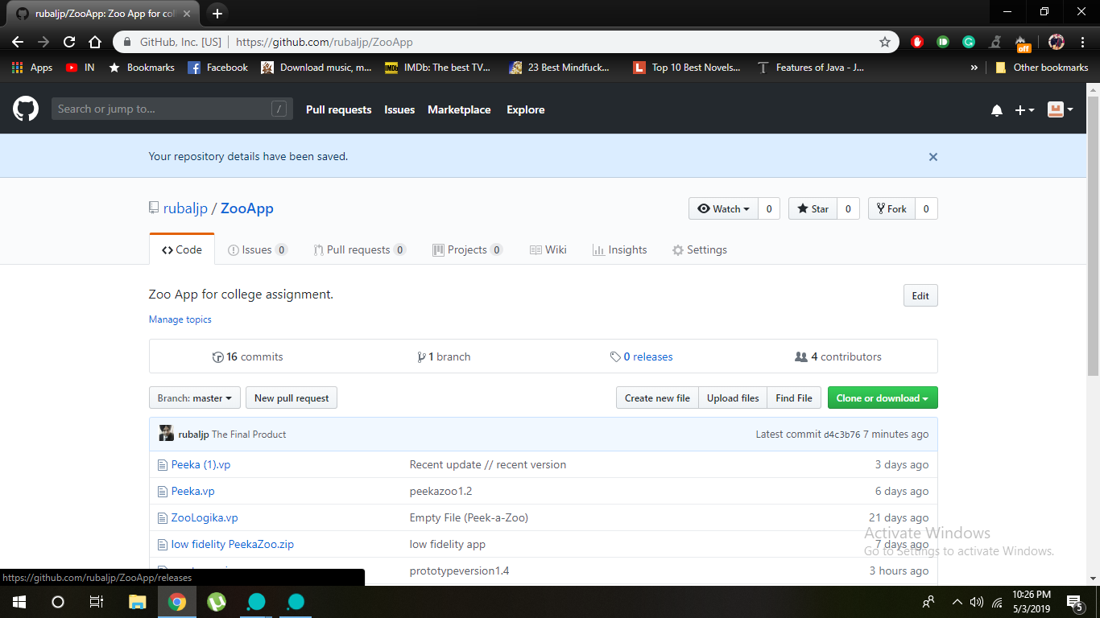
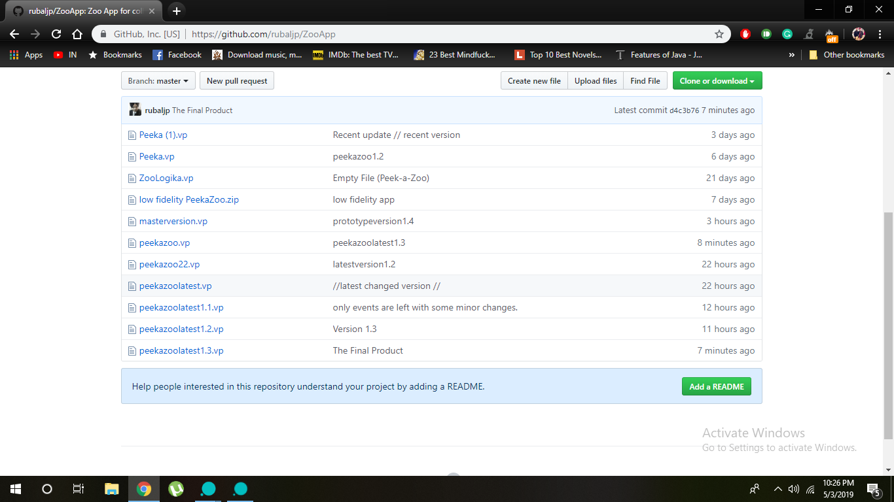
GIT HUB PROGRESS
THE CONTRIBUTORS WERE ADDED.
DIFFERENT TASKS WERE ASSIGN TO EVERYONE.

Slide 18
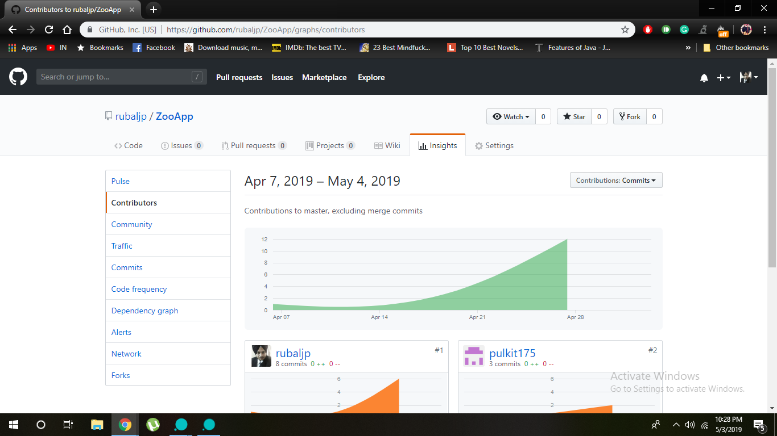
FINAL PROJECT
ACCORDING TO THE TASKS GIVEN IT WAS UPDATED ON GIT HUB.

Slide 19
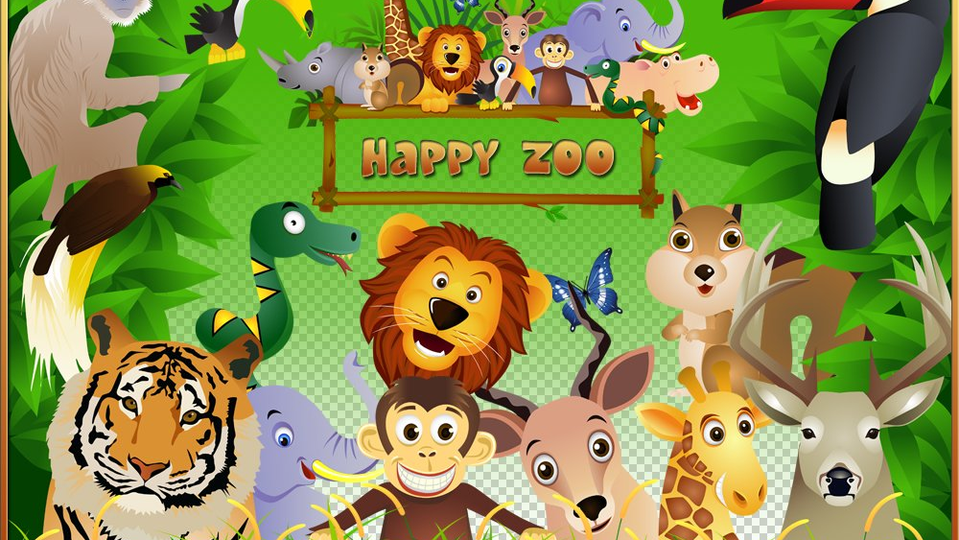
THANKYOU

